Slide 1
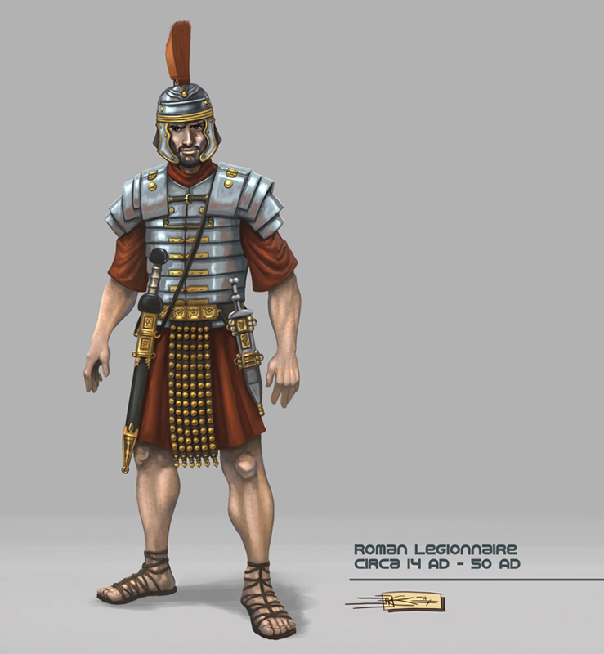
The Romans in Britain

Slide 2
The Romans built a wall across Northern Britain
It was named after the Emperor who commissioned it, Hadrian.

Slide 3
The Wall as it is now

Slide 6
The Wall back in the time of the Romans

Slide 8
The Romans built forts along the Wall

Slide 9
This is how they looked in the time of the Romans

Slide 10
Roman soldiers lived inside the forts in buildings called barracks

